Slide 1
Web Development
CSE343
Section 2

Slide 2
HTML & CSS

Slide 3

What is HTML?
HTML (Hyper Text Markup Language) is the language that builds the structure of web pages
HTML is a set of labels (called tags) you put around content to tell the browser what each piece is: a title, a heading, a paragraph, a picture, or a link.
The browser reads those labels and displays the content accordingly — it doesn’t “think” or run logic, it just follows the instructions in the tags.
HTML describes structure and meaning, not appearance or behavior.

Slide 4
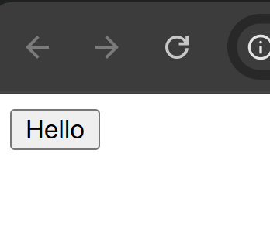
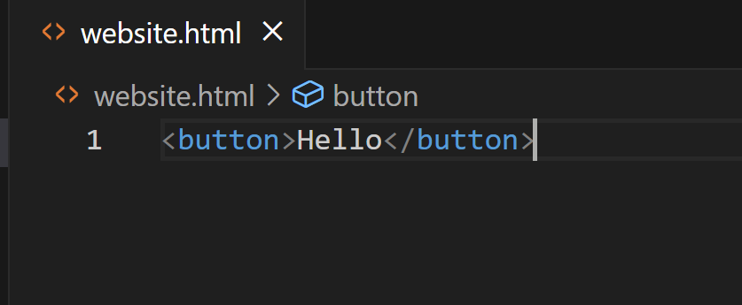
HTML Document
An HTML document is a plain-text file that contains HTML markup (tags, attributes, and text) which describes the structure and content of a web page.
An HTML element is a unit of the webpage structure that the browser understands and renders. It represents a piece of the document — for example, a paragraph, an image, a link, or a section.
In order to define elements in an HTML document, we use HTML tags.
Tags usually come in pairs: an opening tag and a closing tag, and the content goes between them.
Opening tag: <tagname>
Closing tag: </tagname>
Full element: <tagname>content</tagname>
Examples:
<button>Hello</Button> -> this tag creates a button with the text “Hello” inside.

Slide 5
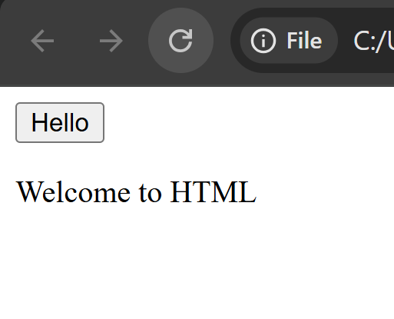
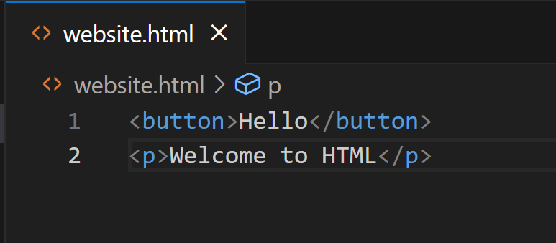
HTML Document (Cont.)
<p>paragraph</p> -> this tag creates a paragraph text with “paragraph” as the text.
The computer reads the HTML document from top to bottom and follows the instructions of the HTML tags to display the structure of the webpage.

Slide 6
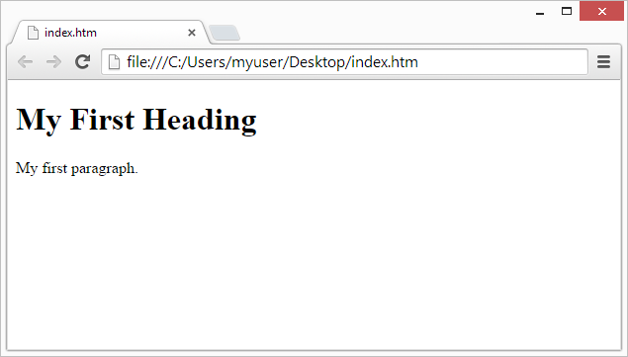
Web Browsers
A browser reads the HTML source and builds an internal structure from it. It doesn’t show the angle-bracket tags to users; instead it uses those tags as instructions to decide what to create and how to arrange it on the screen.

Slide 7
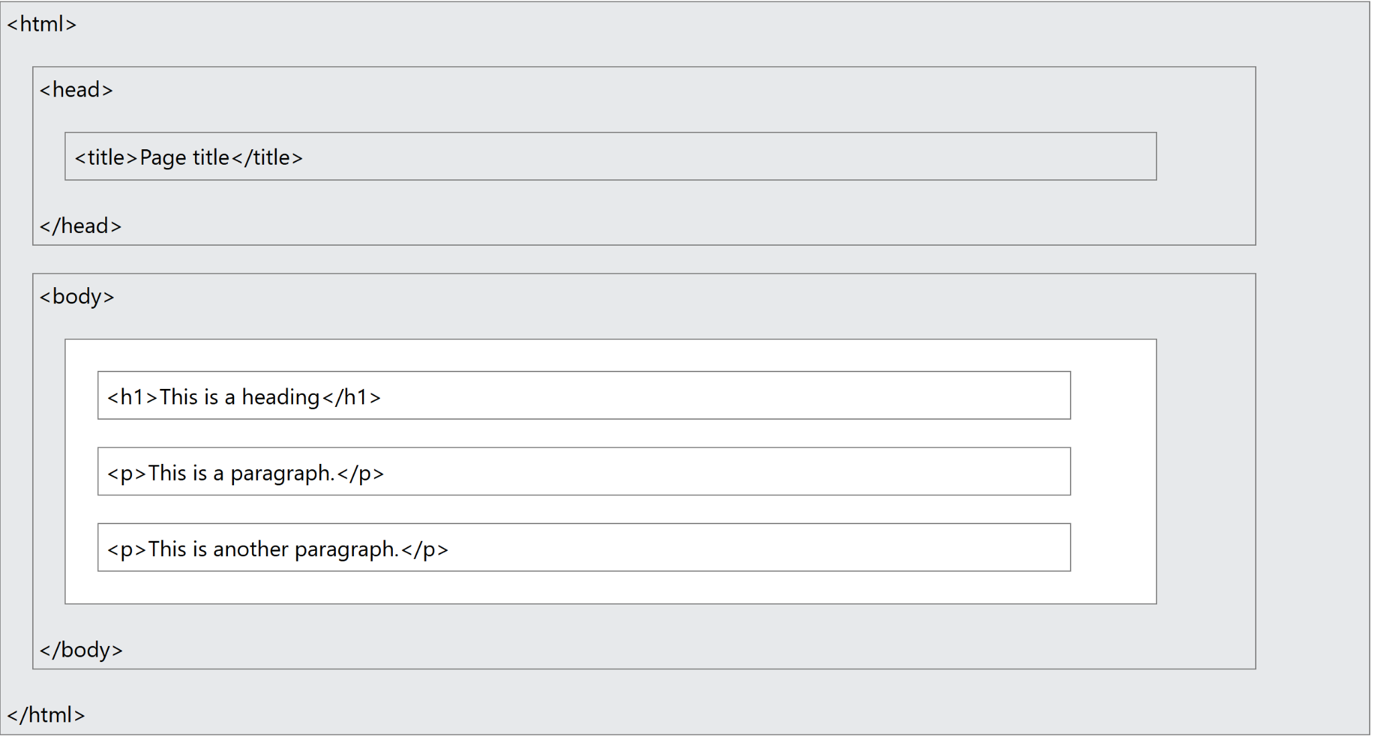
HTML Page Structure
An HTML page is a plain-text document with a fixed outer structure.
Proper structure makes pages behave the same in different browsers and devices.
The structure exists so browsers, tools, and people can reliably understand, render, and work with your page

Slide 8
HTML Page Structure (Cont.)
<!DOCTYPE html>
All HTML documents must start with a document type declaration: <!DOCTYPE html>.
This is not really an element, it is just something that tells the browser to use a modern version of HTML
If we do not write this line, the browser may fall back to older html versions which may contain less features.
This tag does not need a closing tag
<html> </html>
The html element is the root element of the html document
It wraps everything and represents the document itself
<head></head>
The head element (<head>) holds metadata and resources for the document — information the browser and other agents need before rendering the page content. It does not display visible page content itself, but it controls how the page is interpreted, displayed, indexed, and shared.
Usually contains the title element <title></title> which displays the text in the browser tab.

Slide 9
HTML Page Structure (Cont.)
<body></body>
Contains all the elements that are visible inside the webpage

Slide 10
HTML Elements

Slide 11
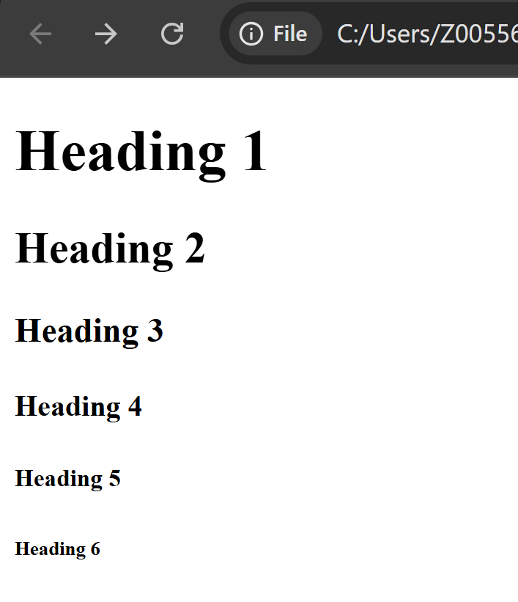
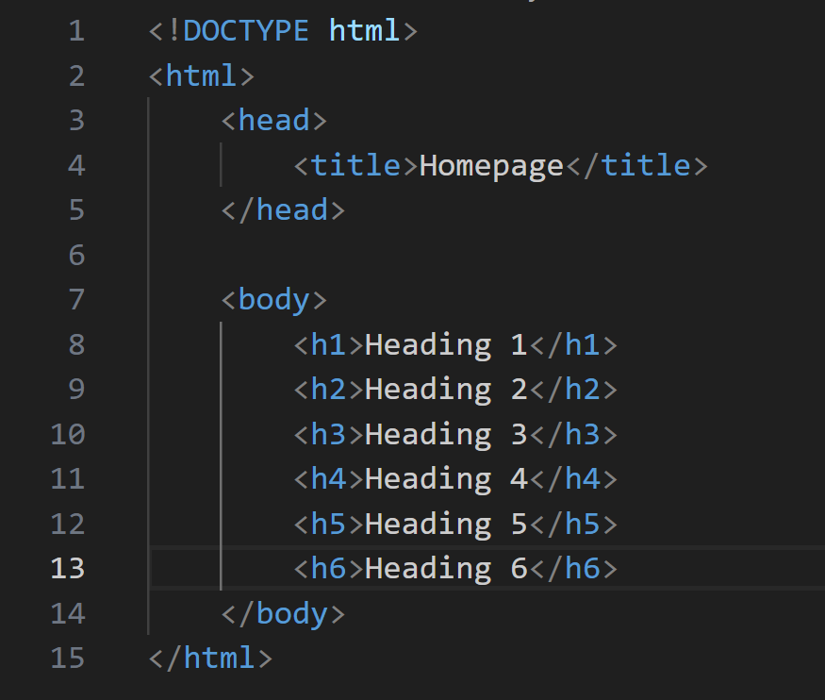
HTML Headings
HTML headings are defined with the <h1> to <h6> tags.
<h1> defines the most important heading. <h6> defines the least important heading
Example:
<h1> Heading 1 </h1>
<h2> Heading 2 </h2>

Slide 12
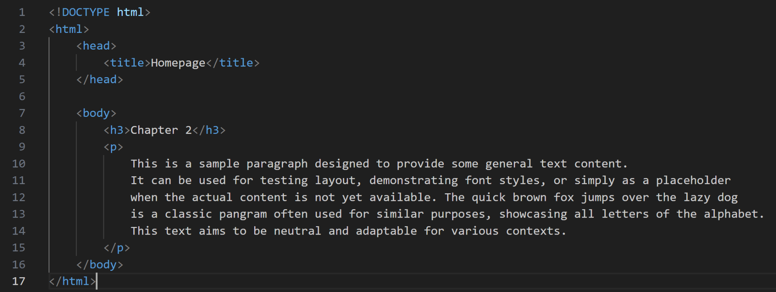
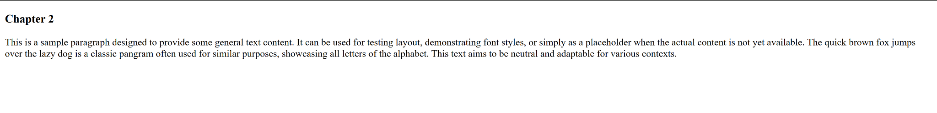
HTML Paragraphs
HTML paragraphs are defined with the <p> tag
It's used to group together a block of related text.

Slide 13
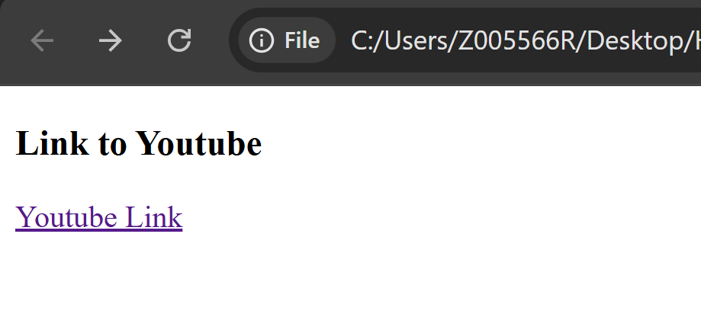
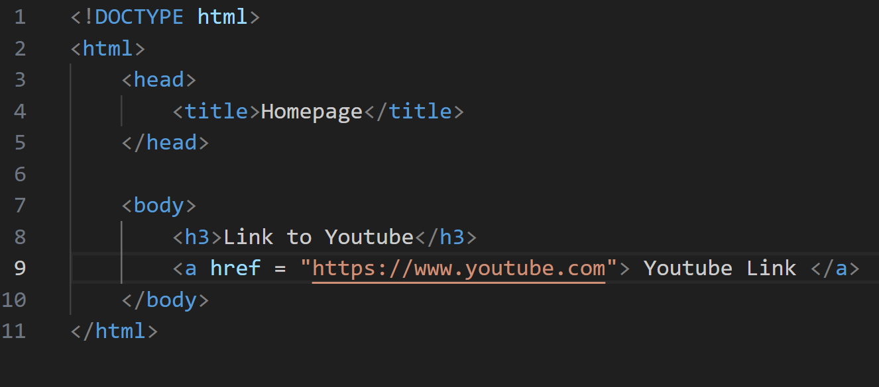
HTML Links
HTML links are defined with the <a> tag:
The link's destination is specified in the href attribute. Attributes are used to provide additional information about HTML elements. Hence the actual tag is written as <a href=”https://www.youtube.com”> Content to appear on Link text

Slide 14
HTML Images
In HTML, an image is embedded into a web page using the <img> tag. Unlike other tags we've discussed (like <p> or <h1>), the <img> tag is a self-closing tag (or void tag), meaning it doesn't have a separate closing tag like </img>. It simply inserts an image at the point where it's placed in the HTML.
The <img> tag relies heavily on attributes to function correctly. Here are the most important ones:
src (Source): It specifies the URL (Uniform Resource Locator) or path to the image file.
alt (Alternative Text): This attribute provides a text description of the image. If the image fails to load (due to a broken src path, slow connection, or user settings), the alt text will be displayed in its place.
width and height: These attributes specify the dimensions of the image in pixels.

Slide 15
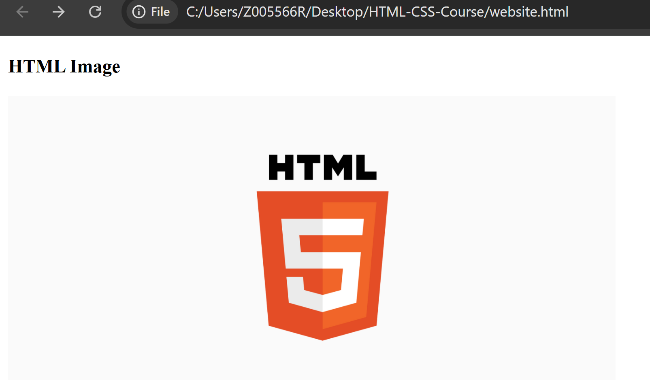
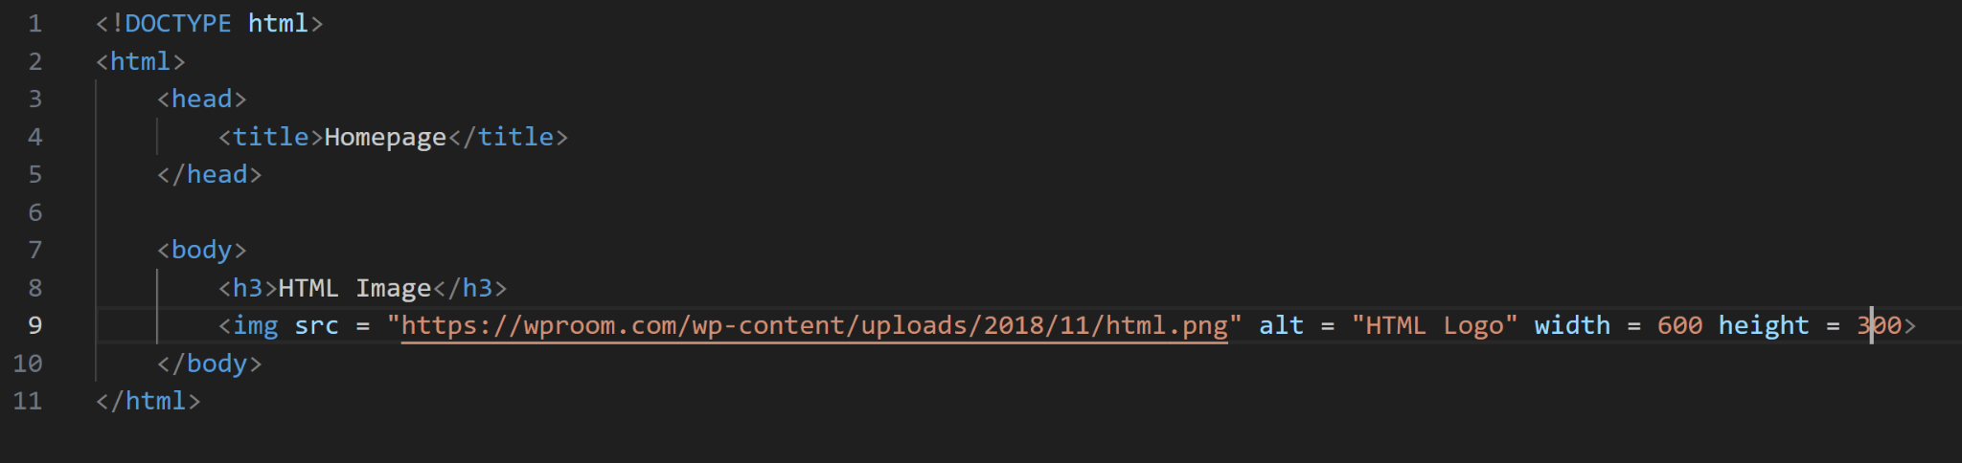
HTML Images (Cont.)
Examples of Images:
Image with Relative path: <img src="images/HTML_logo.png" alt="HTML logo" width="200" height="100">
Image with Absolute URL: <img src = "https://wproom.com/wp-content/uploads/2018/11/html.png" alt = "HTML Logo" width = 500 height = 400>

Slide 16
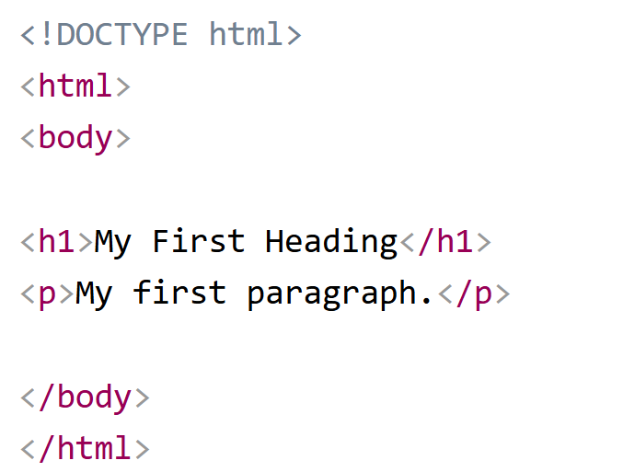
Nested HTML Elements
HTML elements can be nested (this means that elements can contain other elements).

Slide 17
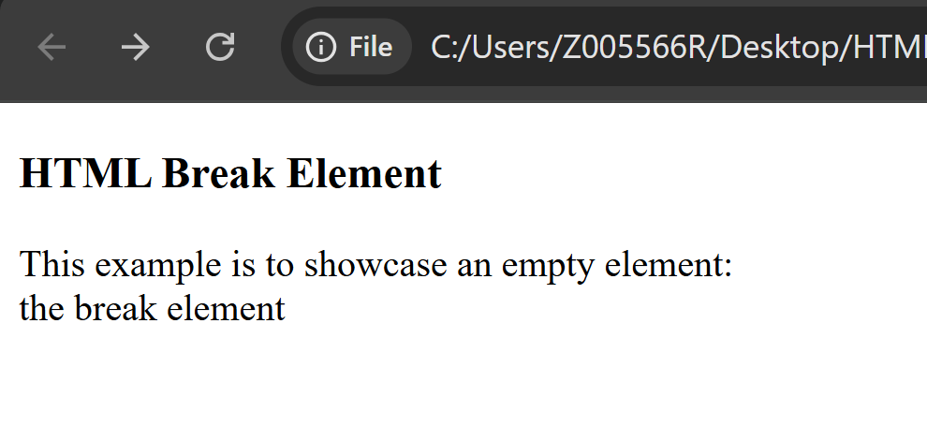
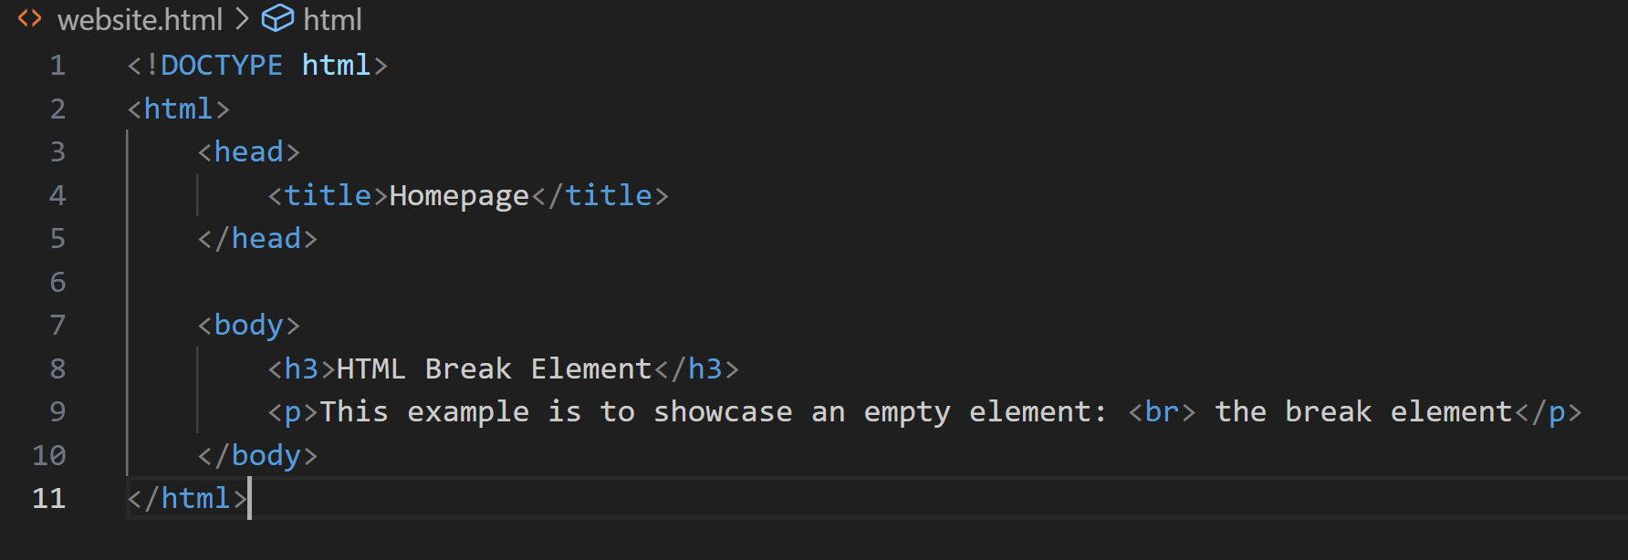
Empty HTML Elements
HTML elements with no content are called empty elements.
The <br> tag defines a line break, and is an empty element without a closing tag:

Slide 18
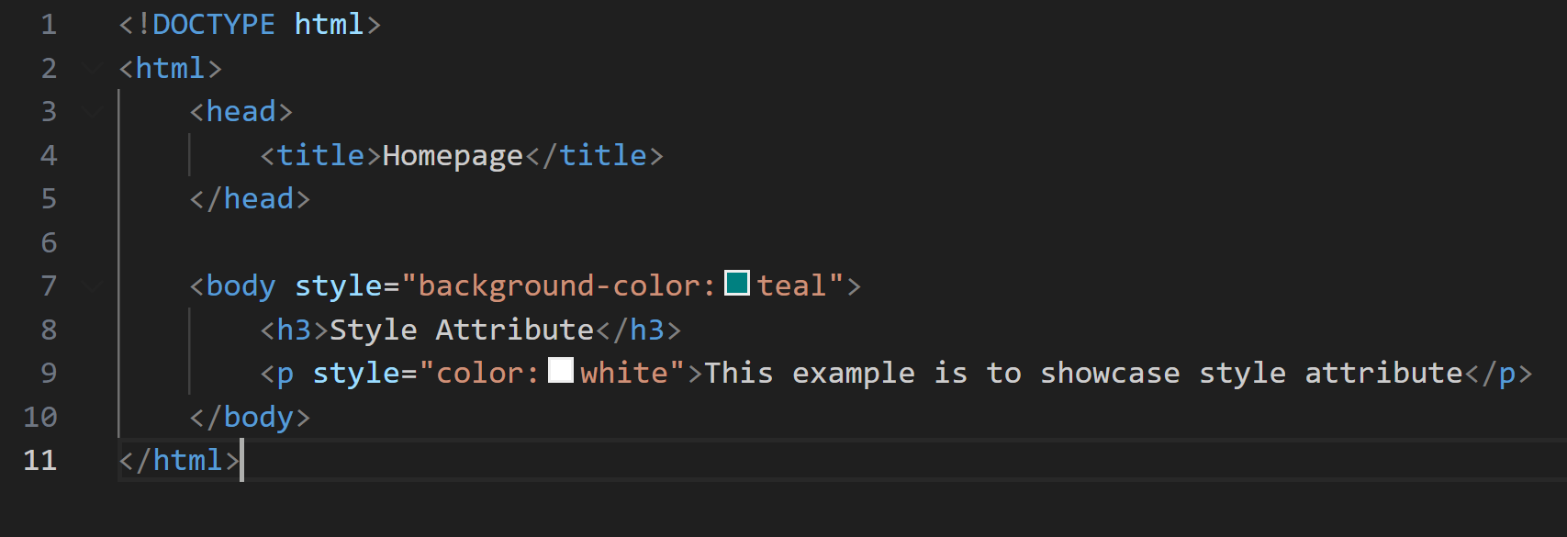
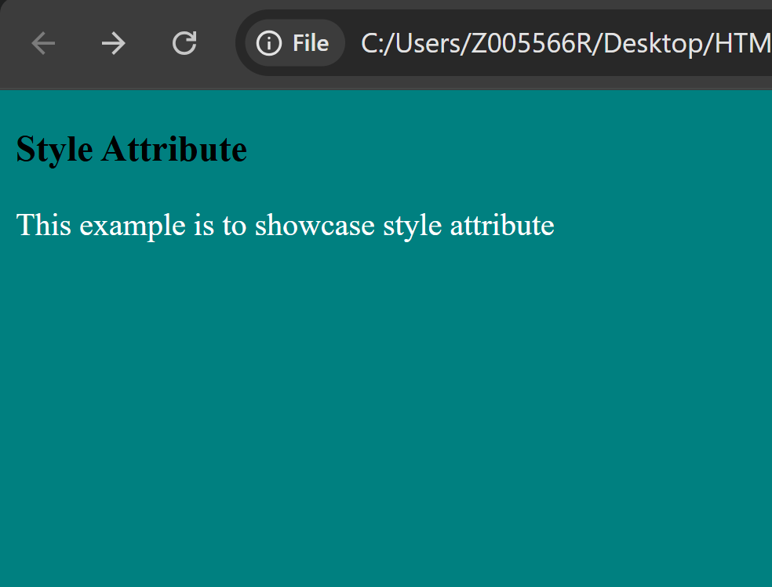
HTML Attributes
All HTML elements can have attributes. Attributes provide additional information about elements
Attributes are always specified in the start tag
Attributes usually come in name/value pairs like: name="value"
Example:
The style attribute: used to add styles to an element, such as color, font, size, and more.

Slide 19
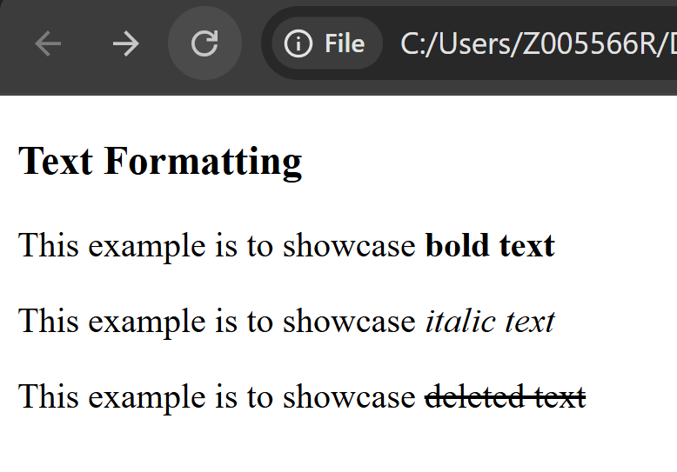
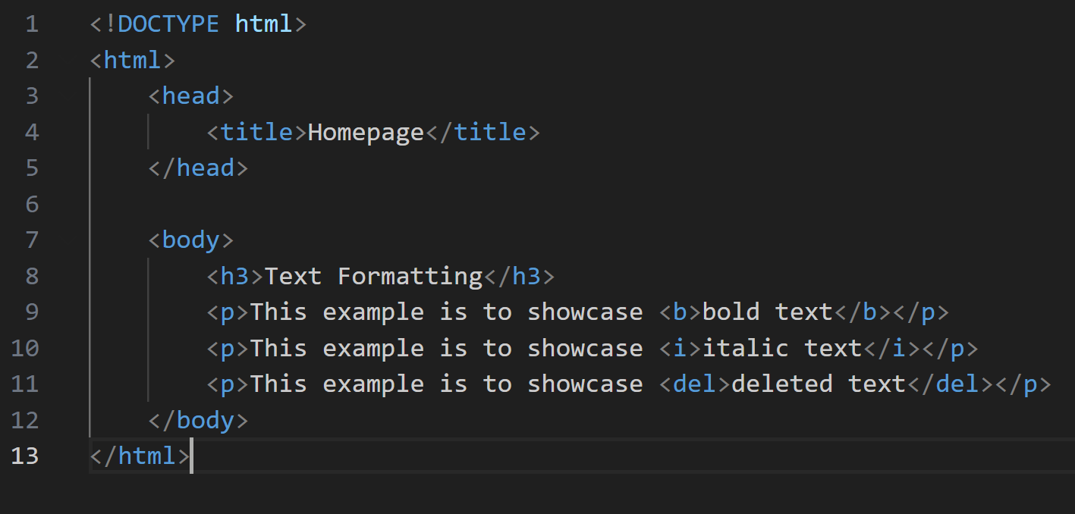
HTML Text Formatting
HTML contains several elements for defining text with a special meaning.
Examples:
<b> </b> - Bold text
<i> - </i> Italic text
<del> </del>: defines text that has been deleted from a document. Browsers will usually strike a line through deleted text

Slide 20
HTML has a lot to offer — there are many tags out there. To learn more about the different elements, check out this website.
HTML Reference

Slide 21
CSS

Slide 22
Introduction
CSS (Cascading Style Sheets) is a style sheet language — a set of rules that tells the browser how to display HTML elements (colors, fonts, layout, spacing, animations, etc.).
While HTML builds the structure (like headings, paragraphs, images, buttons), CSS makes everything look good (colors, layouts, fonts, spacing, animations, etc.).
CSS controls the visual appearance of web pages, allowing developers to define aspects such as:
Layout: Positioning elements, creating columns, and defining spacing.
Typography: Setting fonts, sizes, colors, and line heights of text.
Colors and Backgrounds: Applying colors to elements and setting background images or colors.
Borders and Shadows: Adding visual enhancements to elements.
Animations and Transitions: Creating dynamic visual effects.
Responsiveness: Adapting the layout and styling for different screen sizes and devices.

Slide 23
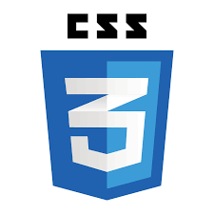
Why use CSS?
In HTML, you can add styles with the style attribute:
<p style="color: red; font-size: 20px;">Hello World!</p>
However, this causes the following problems:
Messy Code: If every element has its own style attribute, your HTML becomes hard to read and maintain.
Repetition: Imagine styling 50 paragraphs with the same color. If you want to change the color later, you’d have to edit all 50 tags.

Slide 24
Using CSS
CSS can be added to HTML documents in 3 ways:
Inline - by using the style attribute inside HTML elements
Internal - by using a <style> element in the <head> section
External - by using a <link> element to link to an external CSS file
The most common way to add CSS, is to keep the styles in external CSS files.

Slide 25
Inline CSS
An inline CSS is used to apply a unique style to a single HTML element.
An inline CSS uses the style attribute of an HTML element.

Slide 26
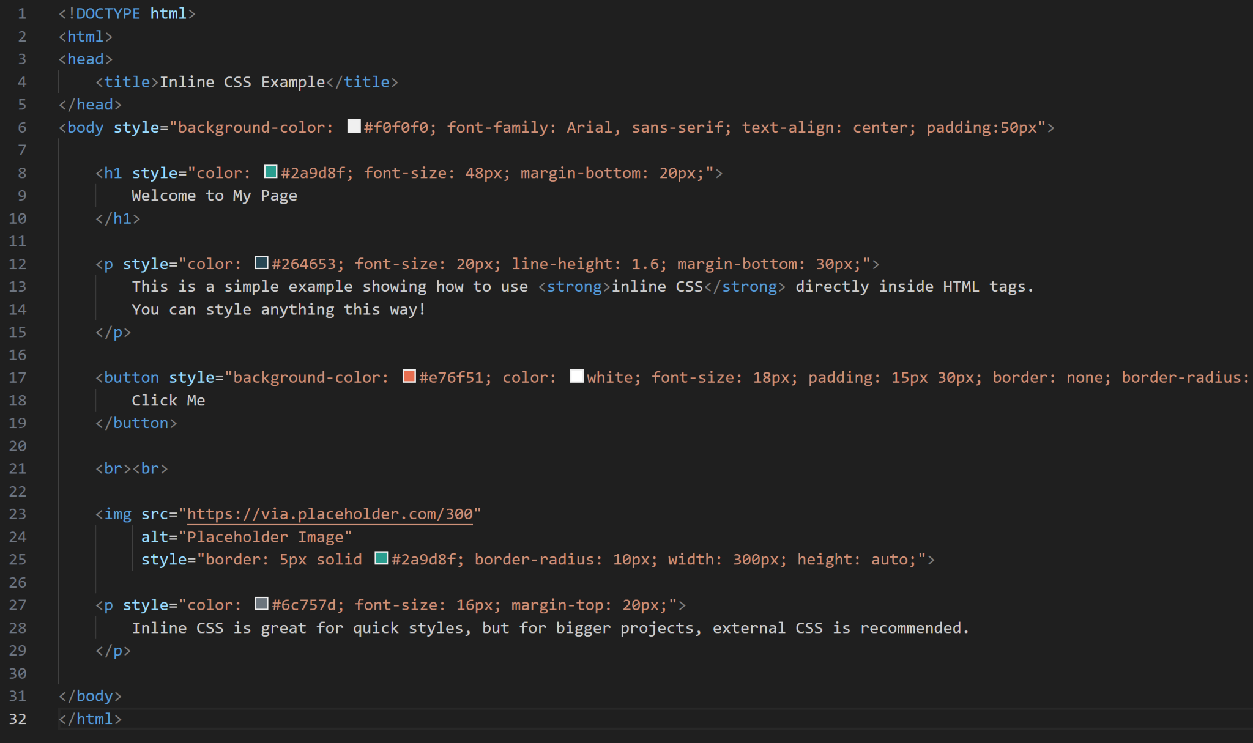

Slide 27
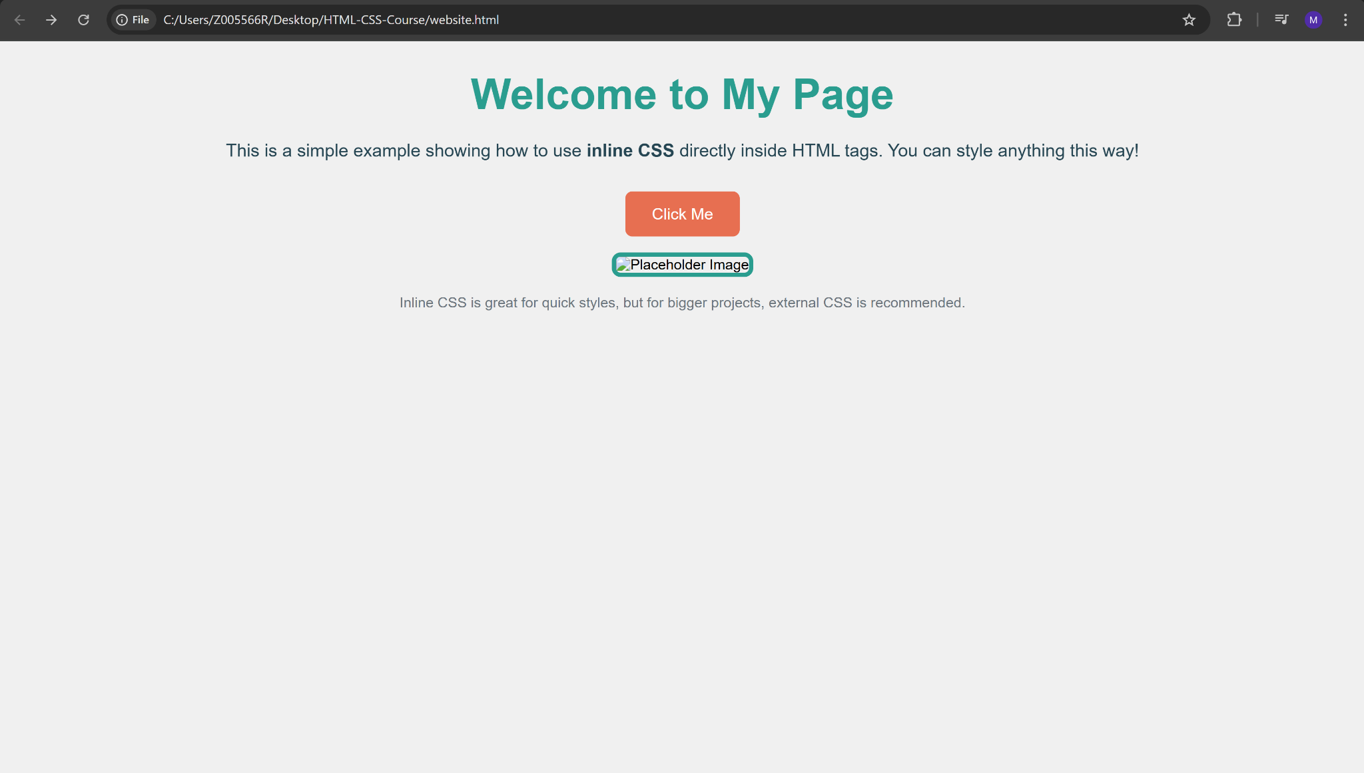

Slide 28
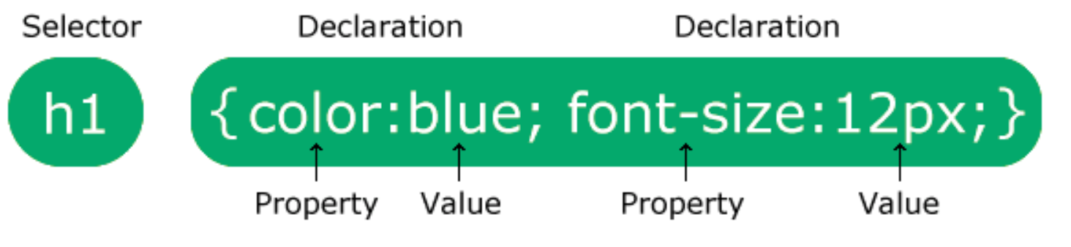
Internal CSS
An internal CSS is used to define a style for a single HTML page.
An internal CSS is defined in the <head> section of an HTML page, within a <style> element.
The selector points to the HTML element you want to style.
The declaration block contains one or more declarations separated by semicolons.
Each declaration includes a CSS property name and a value, separated by a colon.

Slide 29
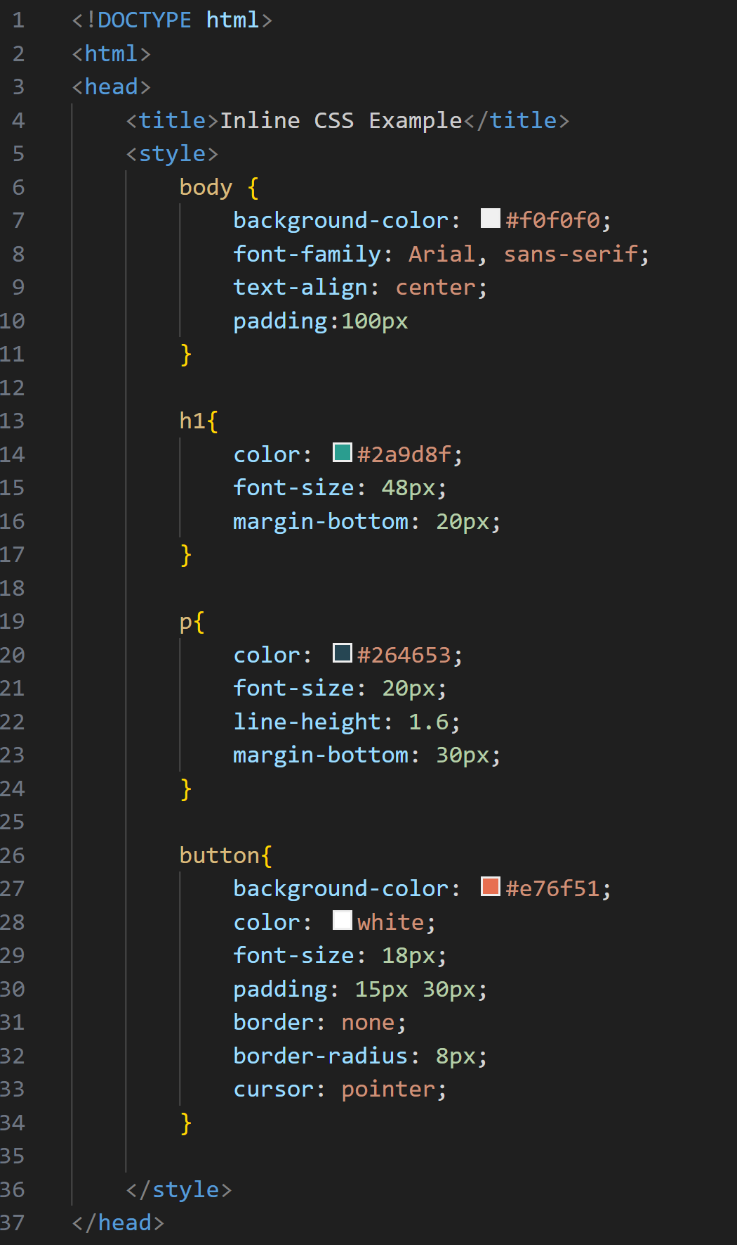
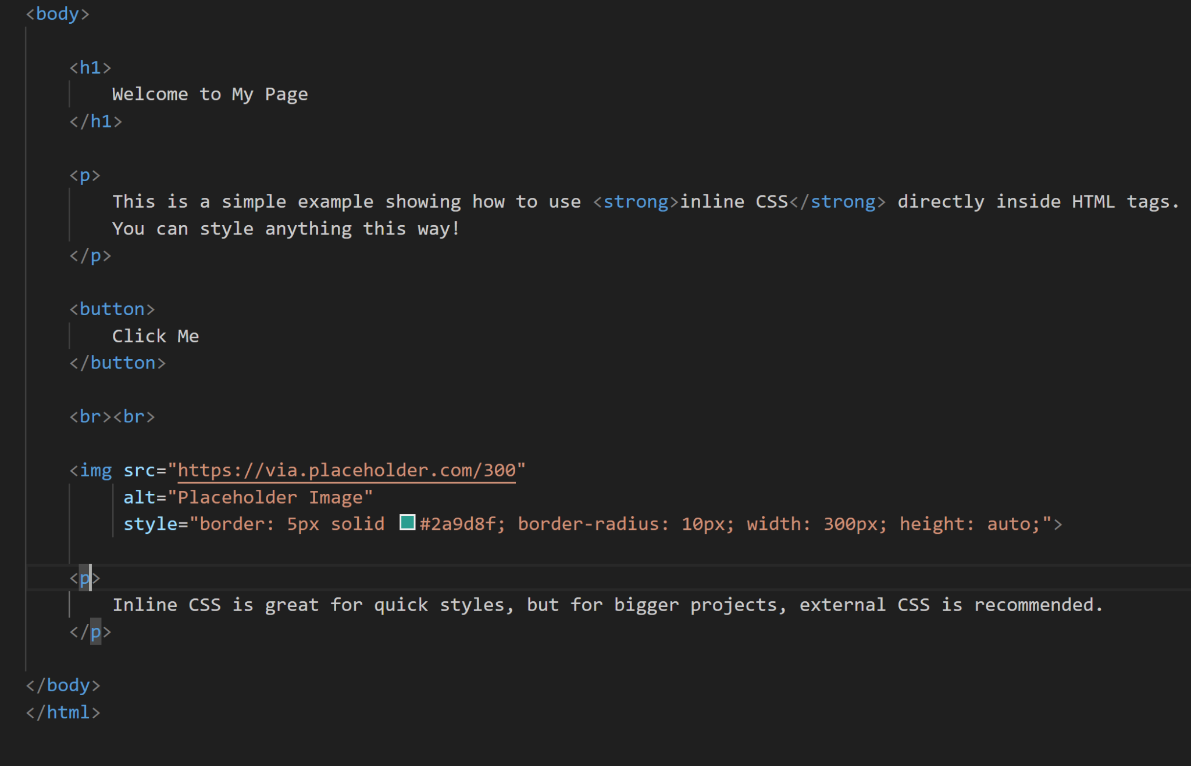

Slide 30
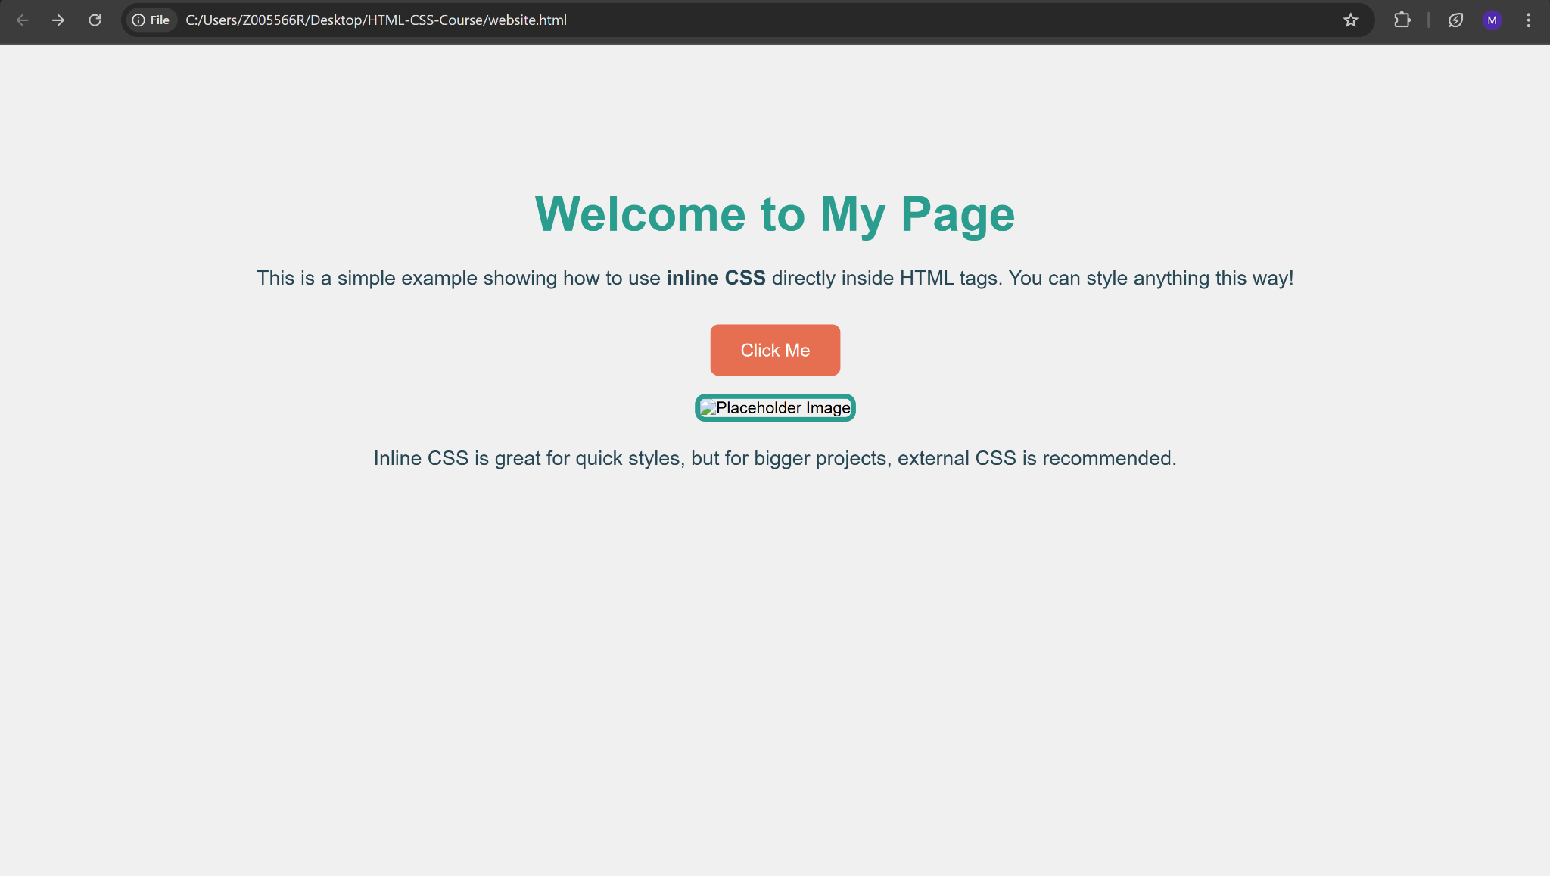

Slide 31
External CSS
External CSS is when you write your CSS in a separate file and then link it to your HTML using the <link> tag.
This separates style from content, making your website cleaner and easier to manage.
Using the link tag:
<link rel="stylesheet" href="styles.css">

Slide 32
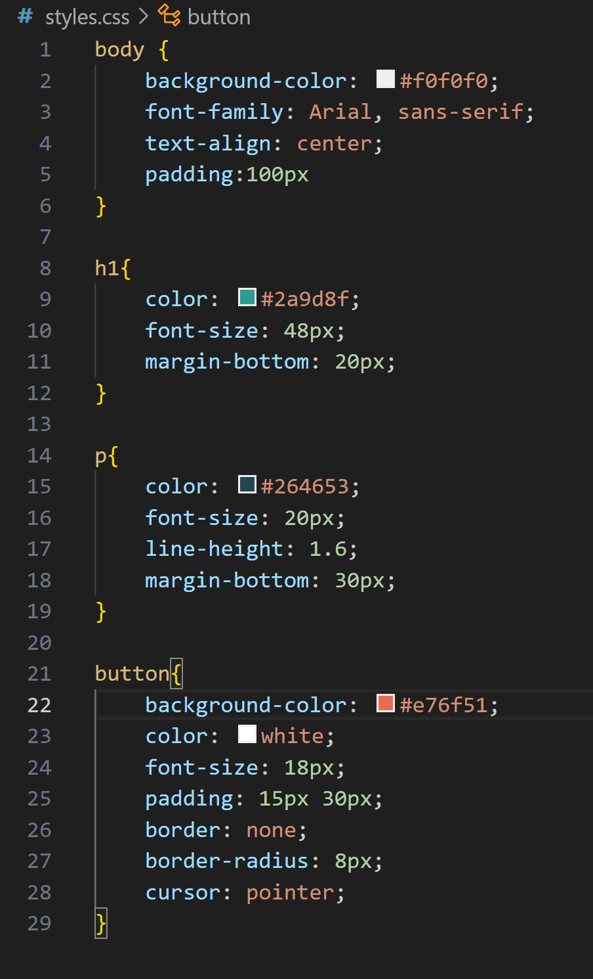
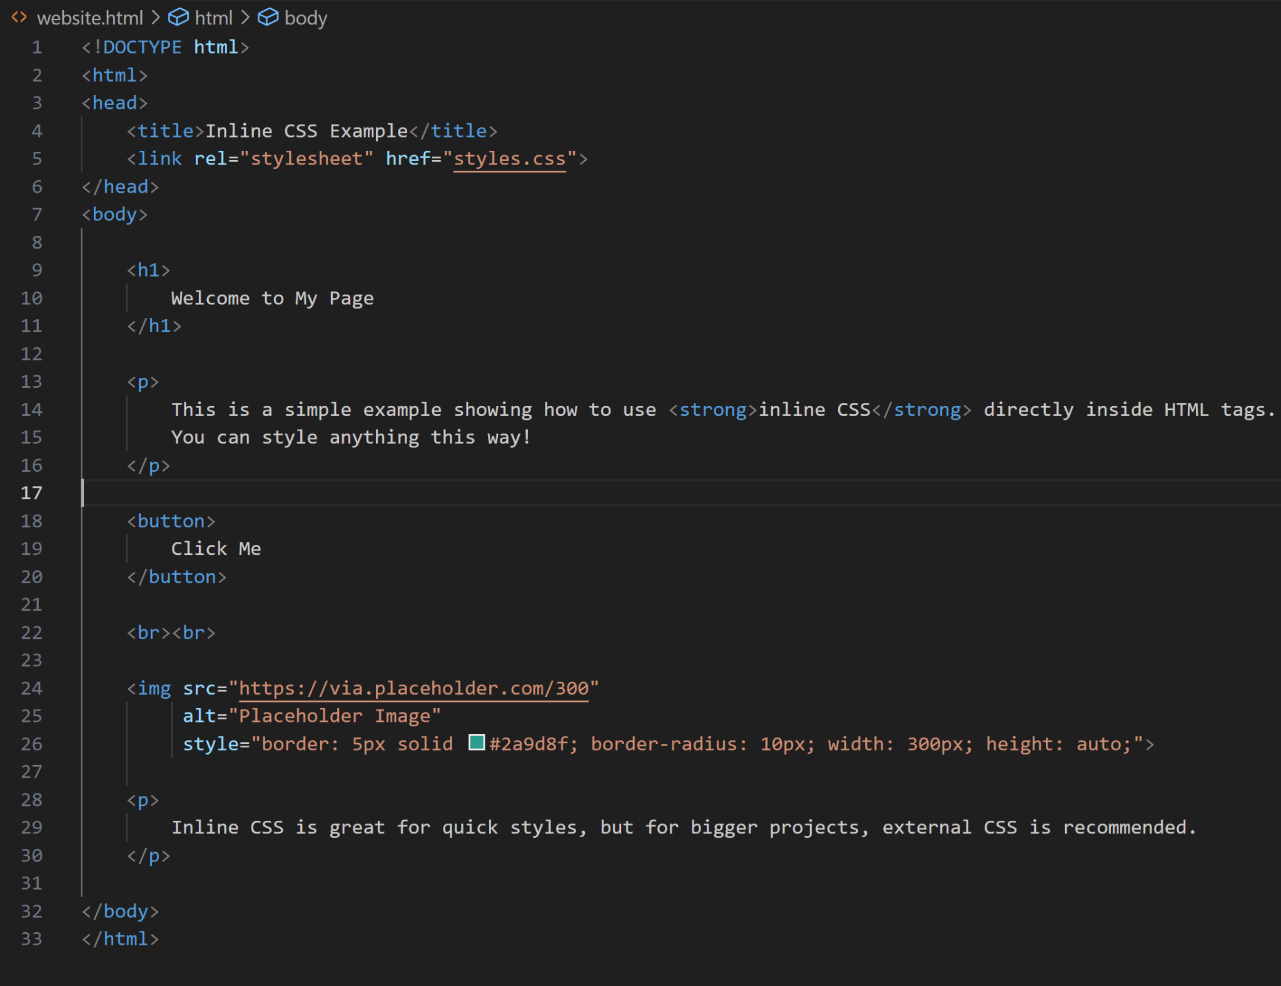

Slide 33
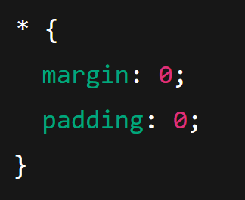
CSS Selectors
A selector in CSS is what you use to “target” (select) HTML elements that you want to style. It tells the browser which elements your CSS rules apply to.
There are several types of selectors:
Universal Selector: Selects all elements on the page.

Slide 34
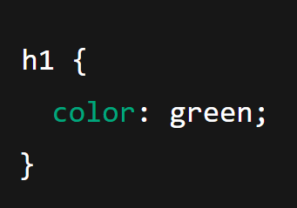
CSS Selectors (Cont.)
2. Type Selector (Element Selector): Selects all elements of a given type.

Slide 35
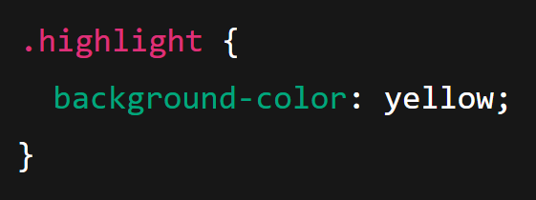
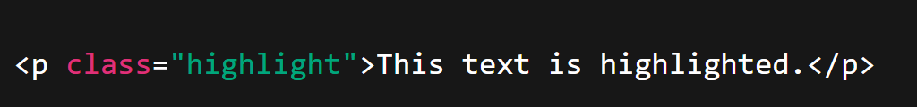
CSS Selectors (Cont.)
3. Class Selector (.classname): Selects elements with a specific class.

Slide 36
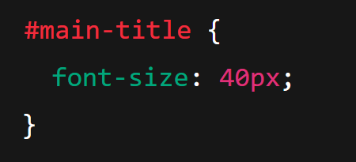
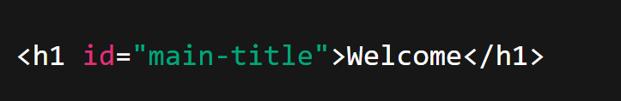
CSS Selectors (Cont.)
4. ID Selector (#idname): Selects a single element with a specific ID (unique).

Slide 37
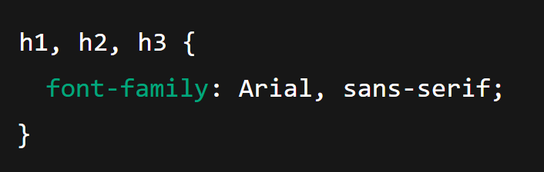
CSS Selectors (Cont.)
5. Group Selector (,): Apply the same styles to multiple elements at once.

Slide 38
Important CSS Points
If some properties have been defined for the same selector (element) in different style sheets, the value from the last read stylesheet will be used.
If two rules have the same specificity, the later one in the stylesheet (or later stylesheet) overrides the earlier.
Inline CSS > ID selectors > Class selectors > Type selectors.

Slide 39
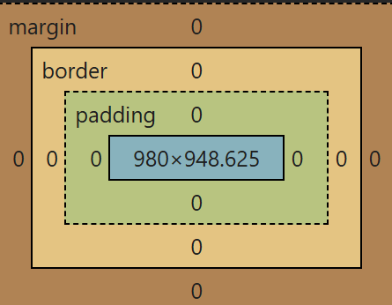
CSS Box Model
The CSS Box Model defines how elements are sized, positioned, and rendered on a webpage.
When a browser loads an HTML document, it assigns a box to each element. This box calculates the element's dimensions and position relative to its parent or the root <html> element, ensuring accurate layout and spacing.
Content Area: The content area is the central part of the CSS box model, containing the main content (e.g., text, images, videos, or elements like <p> or <span>).
Padding Area: The padding area is the space between the content and the border of an element.

Slide 40
CSS Box Model (Cont.)
Border Area: The area that marks the end of an element is called as the border it is the outer fencing for the element.
Margin Area: The area outside the border of an element is called the margin area. Basically this area depends on the parent of the element. The distance between the border of the parent element and the border of the child element is called as the margin.

Slide 41
HTML Layout and Techniques

Slide 42
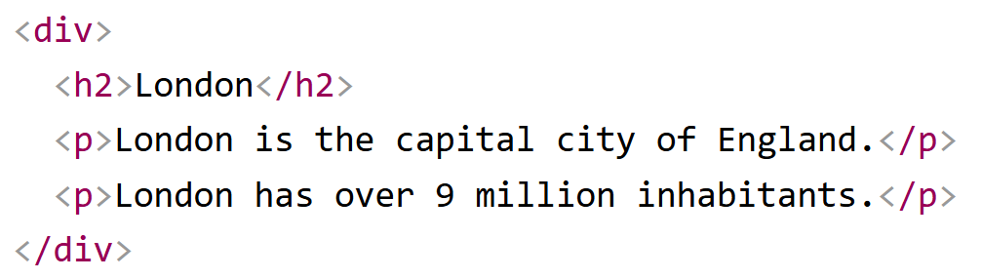
HTML Div Element
<div> stands for “division”.
Div element’s purpose is to group other HTML elements together so you can style it with CSS or manipulate it with JavaScript.

Slide 43
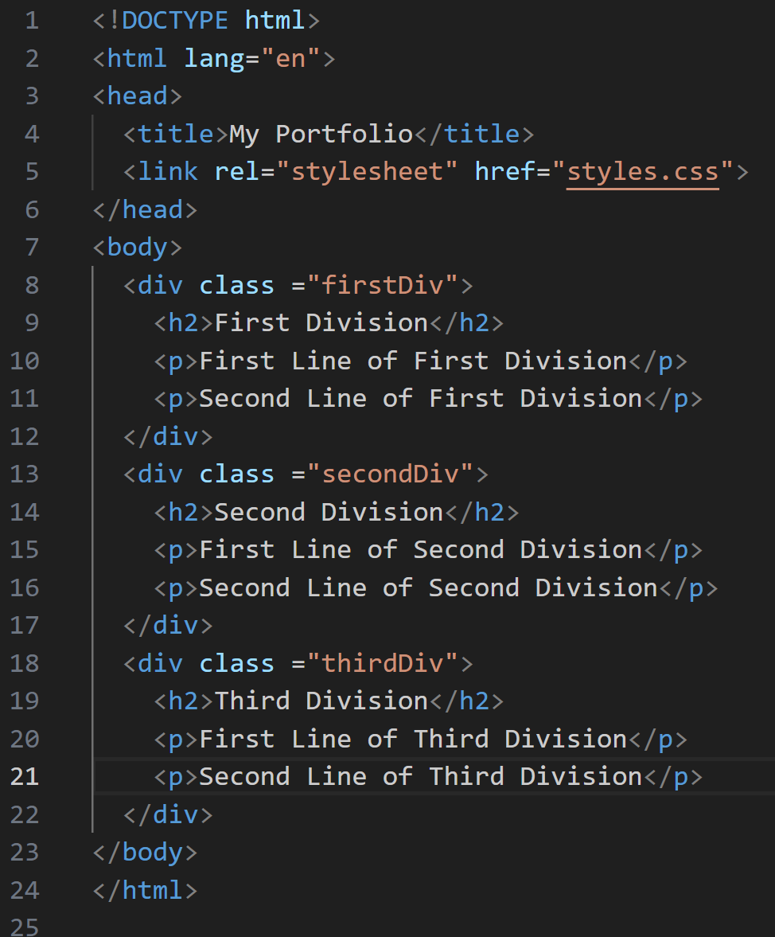
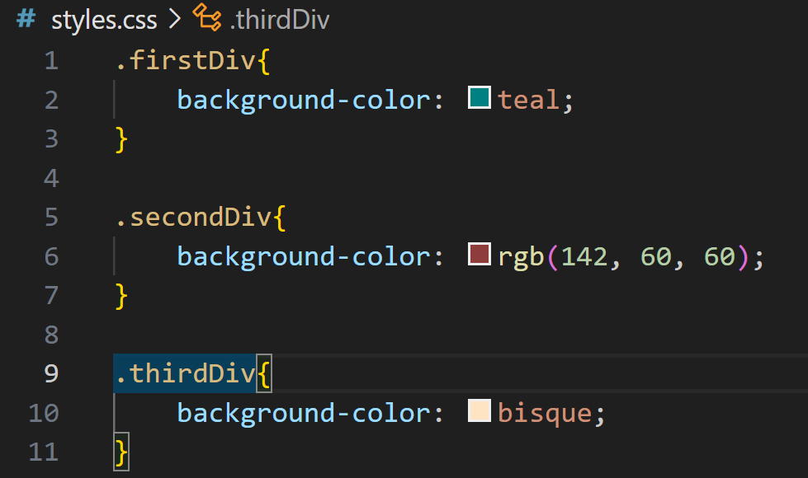
HTML Div Element (Cont.)

Slide 44
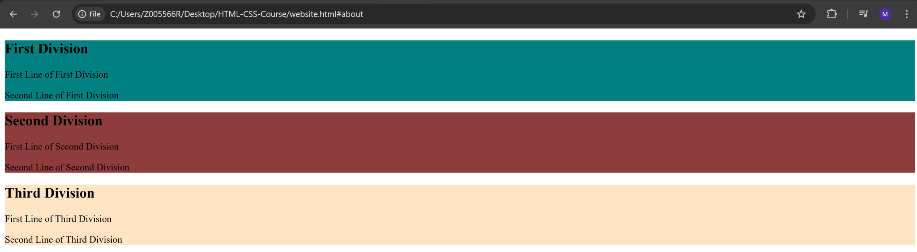
HTML Div Element (Cont.)

Slide 45

HTML Div Element (Cont.)

Slide 46
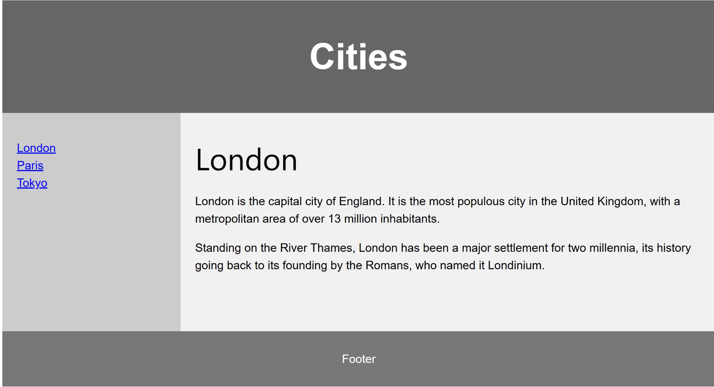
HTML Layout Elements and Techniques
Websites often display content in multiple columns (like a magazine or a newspaper).

Slide 47
Semantic HTML Elements
HTML provides the structure of a web page. Layout is achieved by organizing content into elements such as:
Block-level elements: <div>, <header>, <main>, <footer>, <section>, <article>, etc.
Inline elements: <span>, <a>, <strong>, etc.
You use these elements to create the semantic structure of the page, and CSS is applied to control how they look and align.
Block-level elements start on a new line and take up the full width available (stretching from left to right by default).
Inline elements do not start on a new line. They only take up as much width as their content needs, and they flow within text

Slide 48
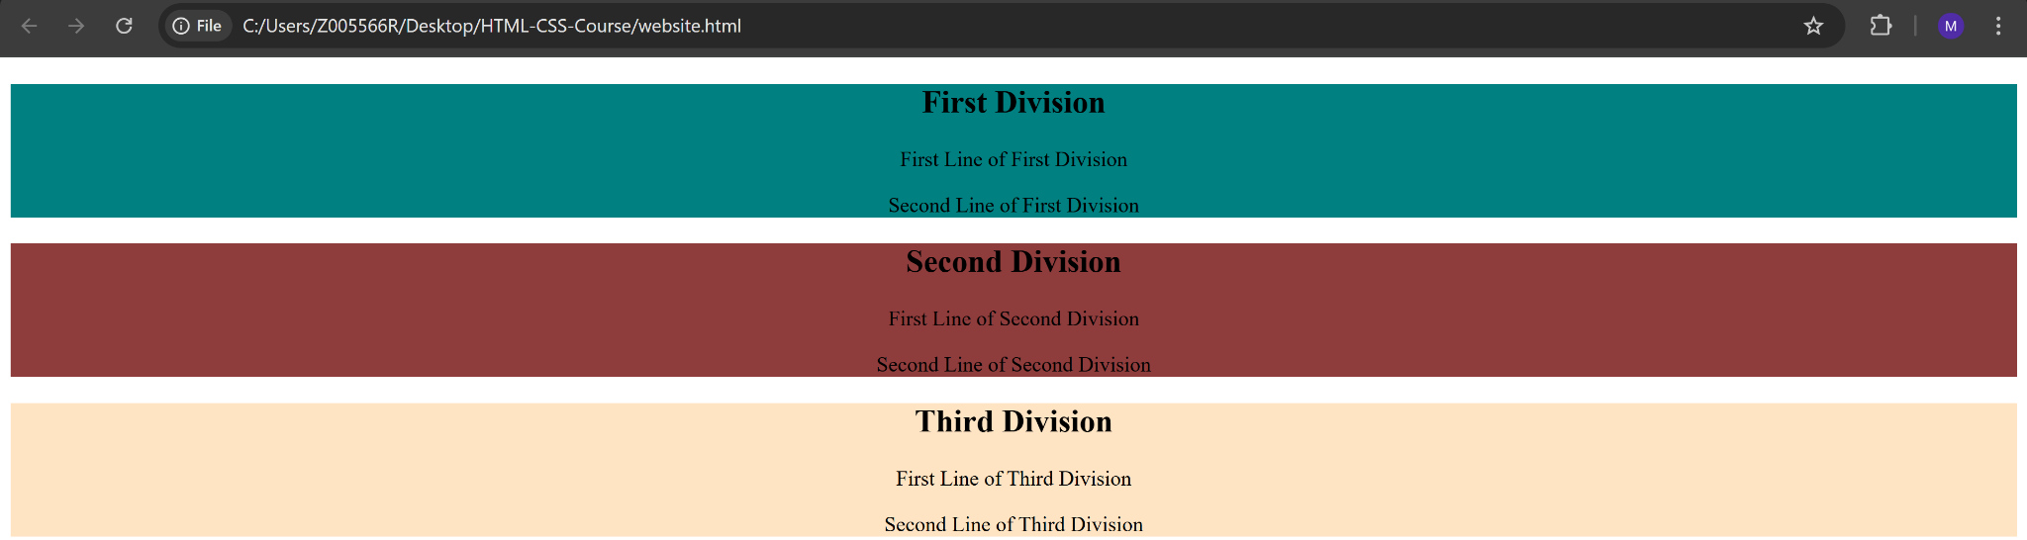
Display Property
The display property in CSS defines how an element is rendered in the layout flow — whether it behaves like a block, inline, or something more advanced like flex or grid.
Block Level Elements:

Slide 49
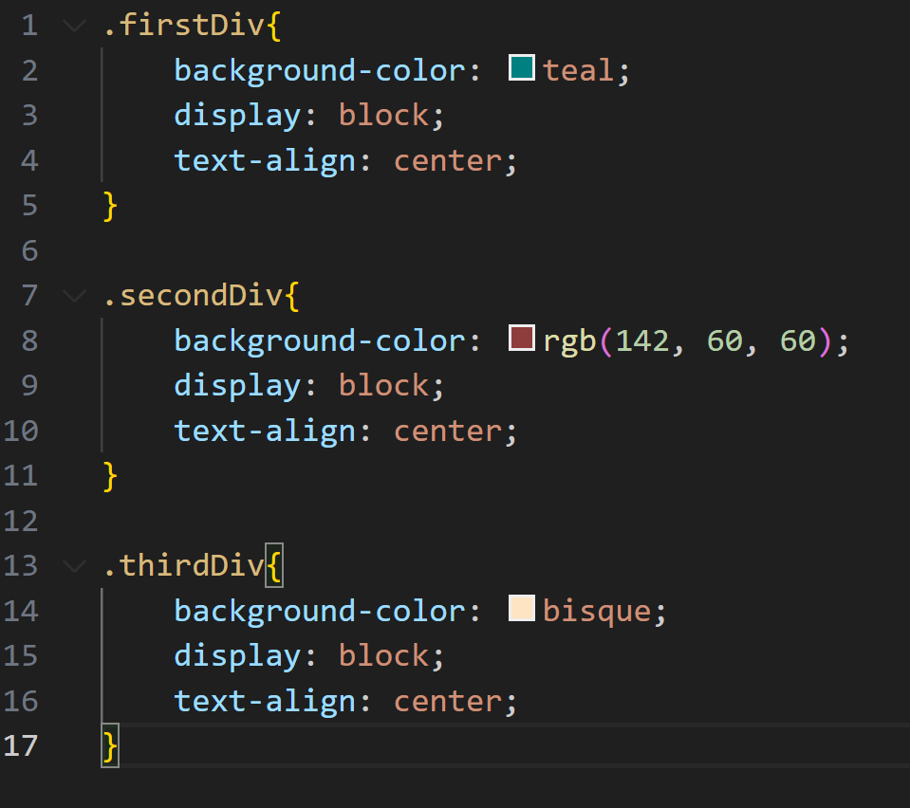
Display Property (Cont.)

Slide 50
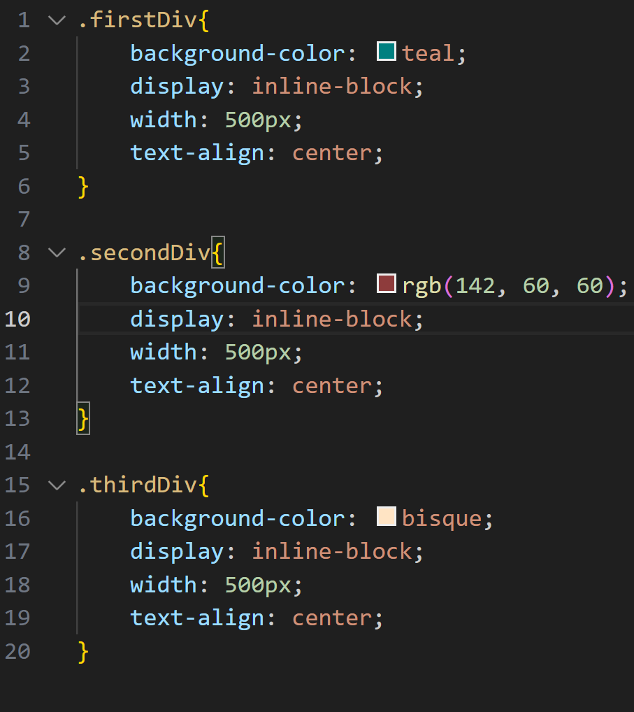
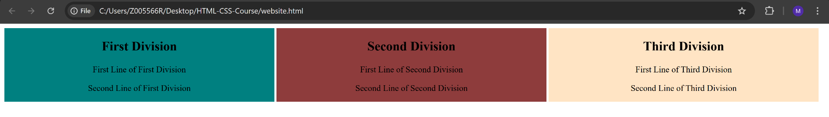
Display Property (Cont.)
Inline Elements:

Slide 51
Lab Demo

Slide 52
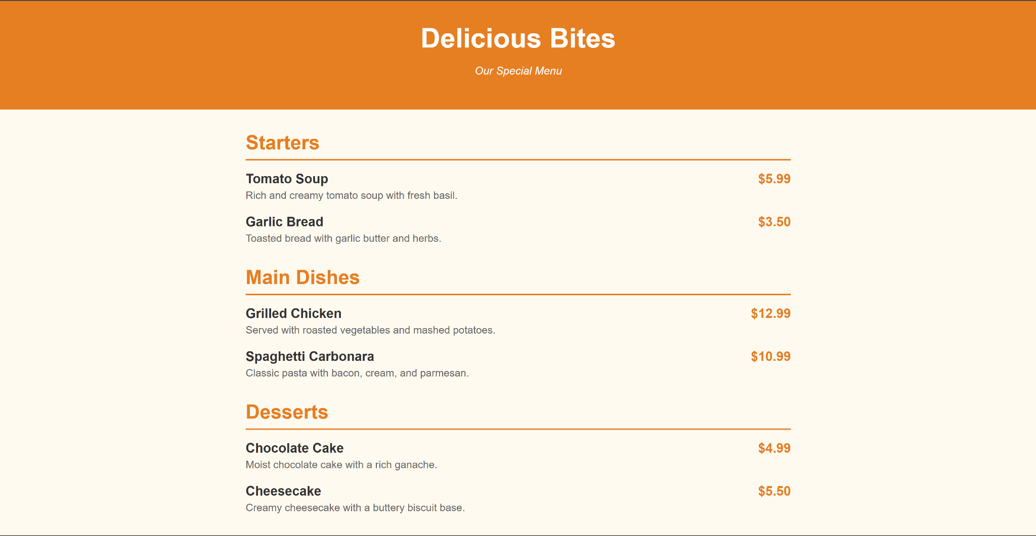
Lab Demo
We are going to implement the following Menu Page

Slide 53
Lab Task

Slide 54
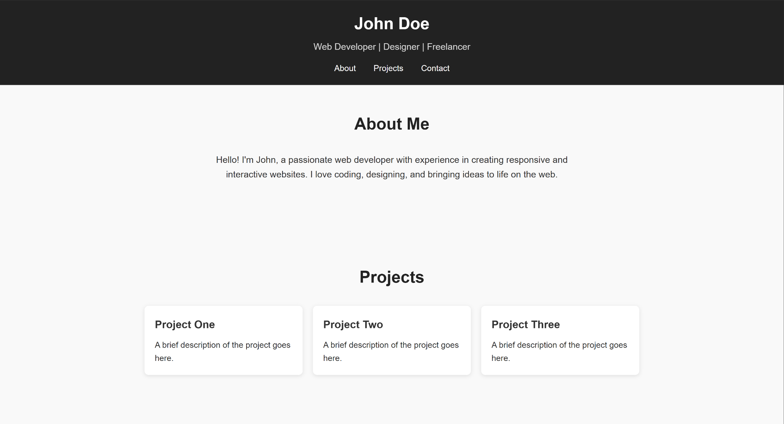
Lab Demo
Create a portfolio page for yourself. Example:

Slide 55
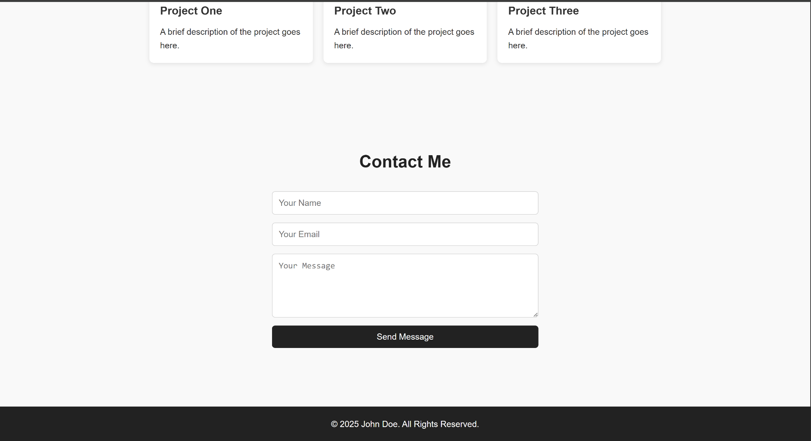
Lab Demo
Create a portfolio page for yourself. Example:

